Slide 1
Outline
Data set description for:
Covid-19 Canada
Covid-19 French
Data-police-shootings

Slide 2
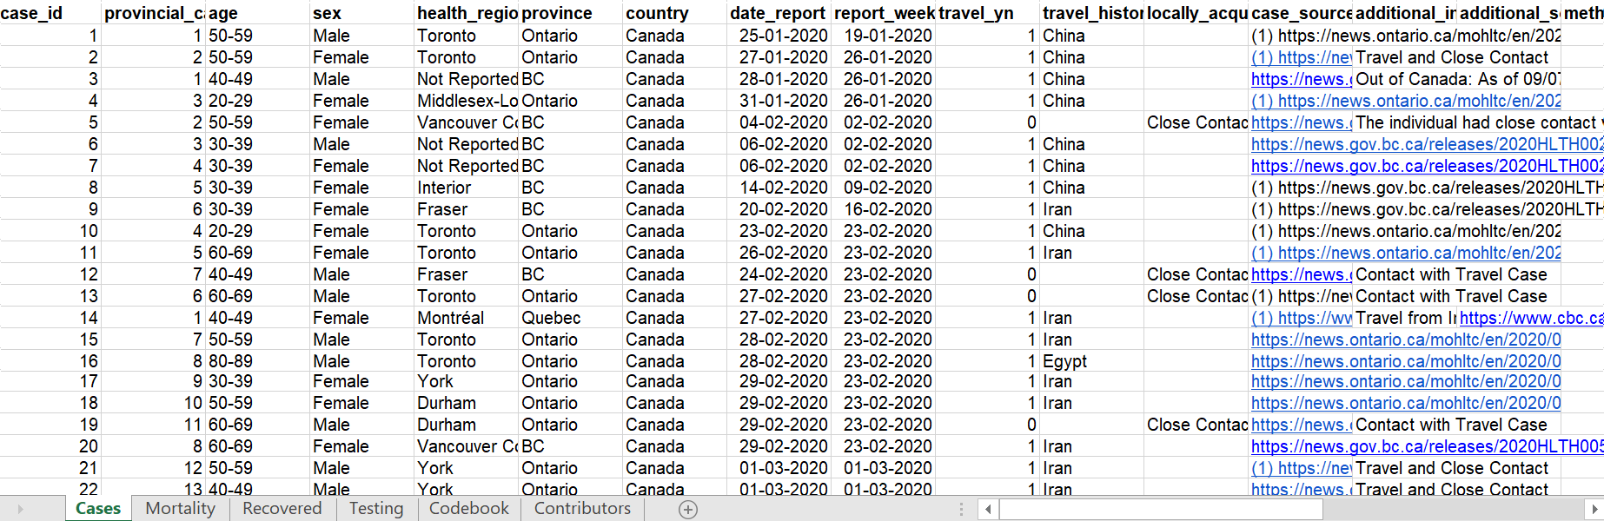
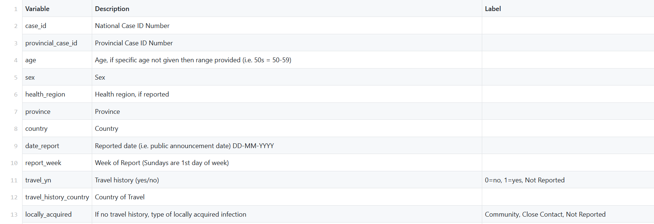
Public_COVID-19_Canada
https://github.com/ishaberry/Covid19Canada/blob/master
https://docs.google.com/spreadsheets/d/1D6okqtBS3S2NRC7GFVHzaZ67DuTw7LX49-fqSLwJyeo/edit#gid=942958991

Slide 3
Public_COVID-19_Canada:
Number of row:
Cases 111,013
Testing cumulative 1,613
Recovered cumulative 2,185
Mortality 8,867

Slide 4
DF Covid Canada data
Sex
Covid-Canada
nb-cases
nb-death
cumulative-recovered
Cumulative-testing
Age
Age-Range
Health-region
Province
Date
Month
Year
Travel continent
Travel country
Travel history

Slide 5
Data Description
Attribute | Description
sex | String: male, female
Age-range | <20;[20,29] [30,39];[40,49] [50,59];[60,69] [70,79];[80,89] [90,99];[100,109] Not reported
Travel history | Boolean: Yes, no, not reported
Travel country | Country of travel
Health region | Health region if reported
cumulative_recovered | Cumulative number of recoveries

Slide 6
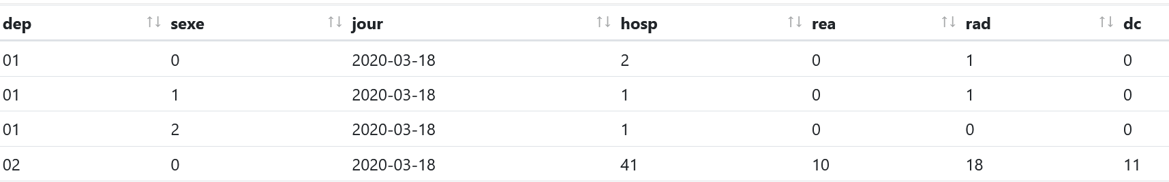
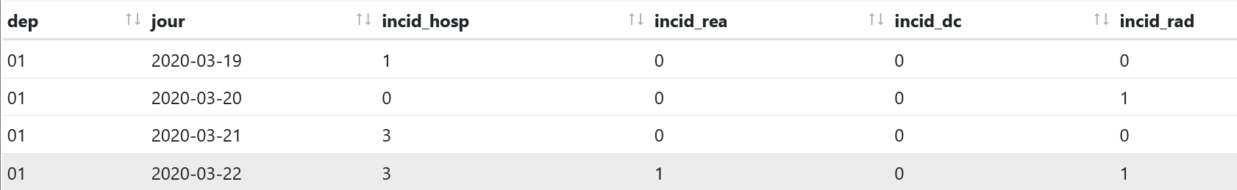
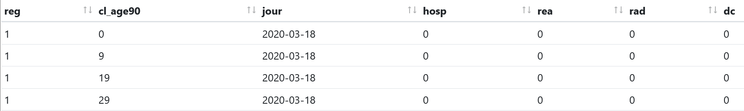
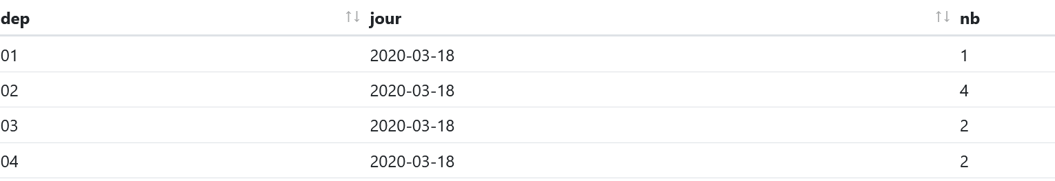
French COVID Data(Data.gouv.fr)
https://www.data.gouv.fr/fr/datasets/donnees-hospitalieres-relatives-a-lepidemie-de-covid-19/#_

Slide 7
French COVID Data(Data.gouv.fr)
Number of row:
Hospital Data according age 2,373
New hospital data 2,121
Test data weekly 6,667
Test data daily 47,269

Slide 8
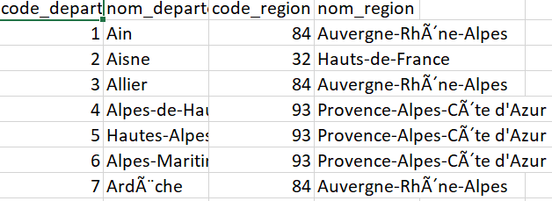
DF Covid French data
Sex
Covid-French
nb-cases
nb-death
cumulative-recovered
Cumulative-testing
Age
Age-Range
Region
Department
Date
Month
Year
Department can be enriched by joining this data: department, region

Slide 9
Data Description
Attribute | Description
department | integer
sex | integer
Age-range | 0 all age; A<15;B 15-44;C 45-64;D 65-74; E>75
hosp | Number of people currently hospitalized
rea | Number of people currently in resuscitation or critical care
rad | Total amount of patient that returned home
Total amount of deaths at the hospital | Total amount of deaths at the hospital

Slide 10
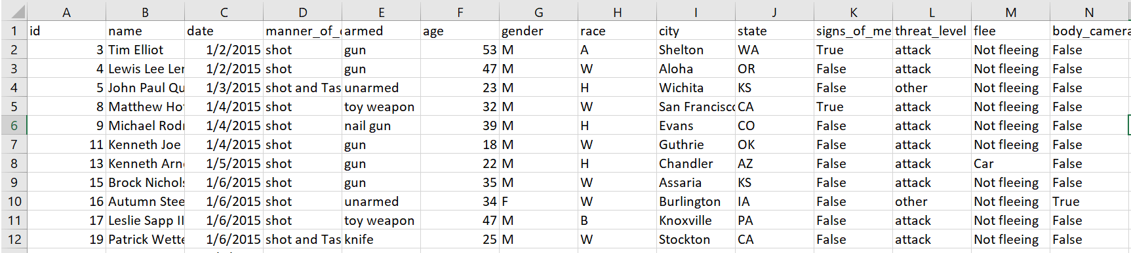
Data-police-shootings
https://www.kaggle.com/mrmorj/data-police-shootings
Total row: 5,417

Slide 11
DF data-police-shootings
Age
race
armed
Police-shooting
number of shooting
Signs-mental-illness
gender
State
City
Day
Month
Year

Slide 12
Data Description
Attribute | Description
Age | integer
armed | String: gun, knife, unarmed…
gender | String: M, F, none
race | W: White, non-Hispanic B: Black, non-Hispanic A: Asian N: Native American H: Hispanic O: Other None: unknown
signs_of_mental_illness | Boolean: True, false

Slide 13
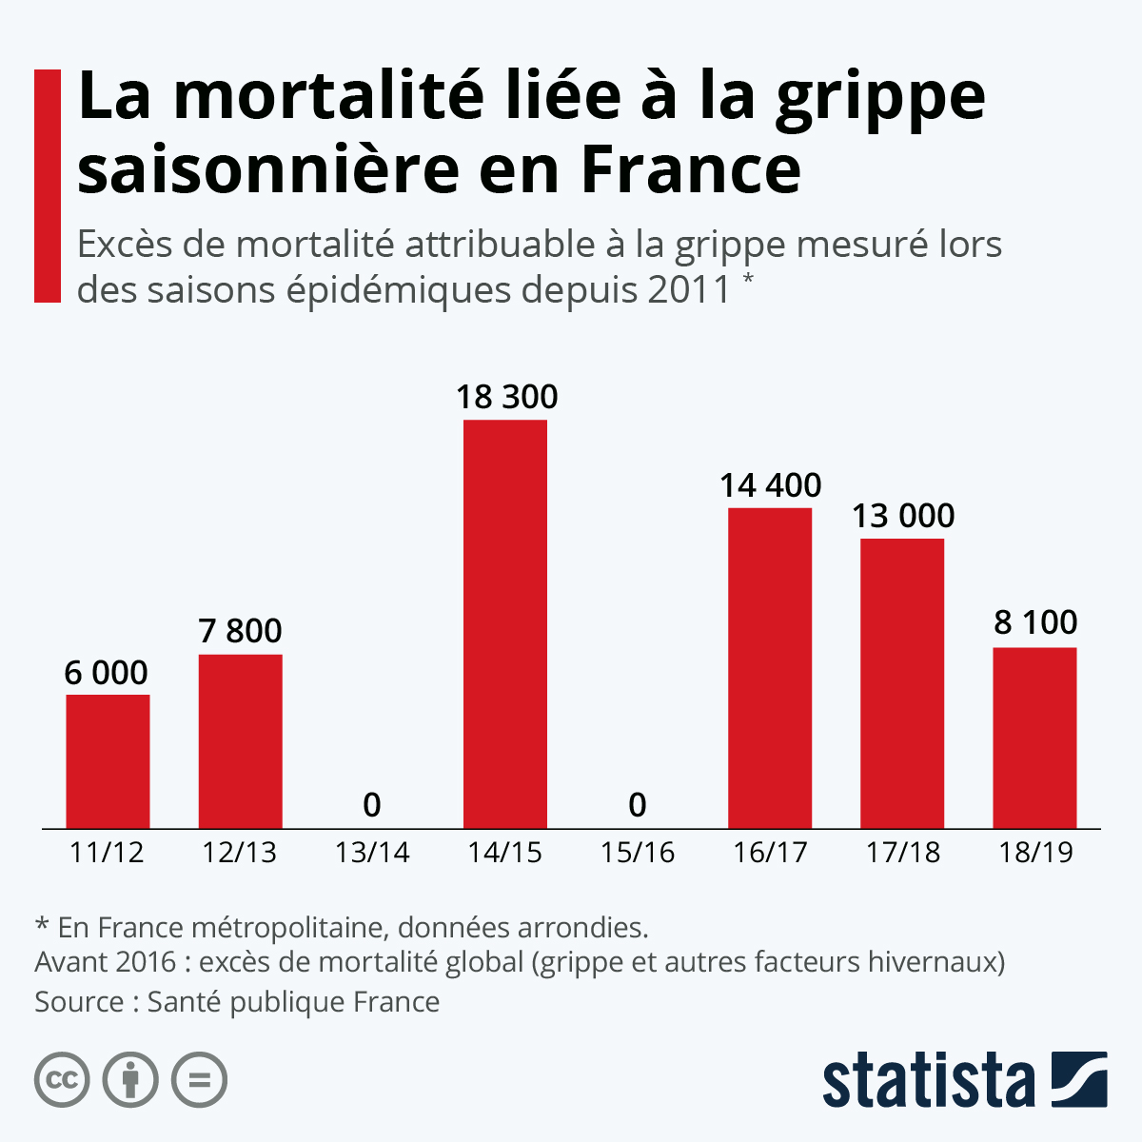
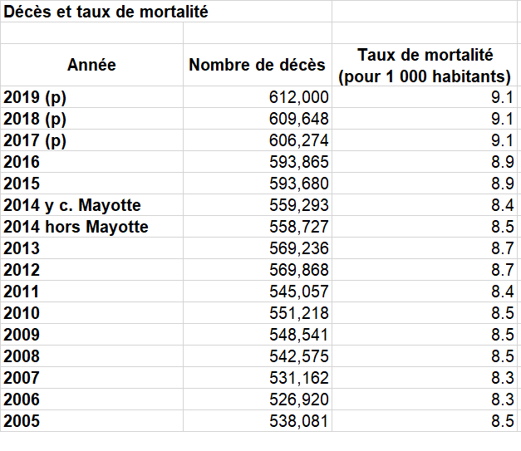
Benchmark
Excess seasonal flu mortality in France between 2011 and 2019
Death and mortality rate in France
https://www.insee.fr/fr/statistiques/2383440
https://fr.statista.com/infographie/11358/mortalite-de-la-grippe-en-france/

